Slide 1

David Van Brackle (vanb)
Chief Judge, Southeast USA Region, ICPC

Slide 2

Ensuring the accuracy of judge data can be a challenge.
In the SEUSA, each of the judges writes a solving program, to confirm the validity of the judge input and output, but even still, there are issues that can go undetected.
  Extra spaces, blank lines, values outside of specified ranges, etc.

Slide 3

The SEUSA judges are mainly former competitors who write very robust programs, which are often immune to troubles caused by such simple formatting and constraint errors.
However, these kinds of issues can cause problems with competitor’s code during the contest, causing, at best, extra effort and delays by the judges during the contest, and at worst, incorrect judge responses.

Slide 4

In 2009, one input set had a space following a single number on a line
In 2010, a change in formatting from “all-on-one-line” to “one-per-line” wasn’t reflected in the data set until close to the contest
In 2010, a change in a data constraint wasn’t reflected in the sample input

Slide 5

3) VIVA will tell you about any extra spaces, extra characters on lines, blank lines, constraint violations, etc.
{
n (0<=n<=100);
}
1) First, describe your input file using a simple pattern description language, and load it into VIVA (VIVA will tell you about any syntax errors.).
Extra blank(s) on line 2
At line 3 token 1: Failed constraint:
1 <= n && n <= 100
Unused tokens on
line 4
VIVA
2) Next, run VIVA on your judge input files.
19
34
102
4 2

Slide 6

Variable ( Constraints )
Constraints are optional. Multiple constraints can be separated by commas.
Examples:
x
n (n<3)
k (0<=k<=10, k!=5)
You can put multiple patterns on a line terminated with a semicolon. This means that all of the integers must appear on the same line, with a single space between them, and no leading or trailing blanks. Constraints can use any previously mentioned variable.
Examples:
x (0<=x<=100) y (0<=y<=100);
m n (0<n<=20, n<m<=30);
p q (0<p<q<80) r (0<r<p*q);

Slide 7

Repeating lines are inside {}’s. Without a terminating condition, {} means “Repeat until EOF”.
Example:
{
x y (0<x, 0<y);
}
Means: Read pairs of positive integers, one pair per line, until EOF. Generate an error if there are any leading or trailing blanks, more or less than 2 integers, more than a single space between them, any negative integers or zeros, etc.

Slide 8

{ [ Type Condition ] Patterns }
Two kinds: Line Count (Type = ‘*’), and Sentinel Value (Type = ‘=‘).
For example:
n (0<n<=20);
{[*n]
x y (0<x, 0<y);
}
Means: Read an integer n, 0<n≤20. Then, read 20 lines of x’s and y’s.
{[= x y (x=y=0)]
x y (0<x, 0<y);
}
Means: Keep reading lines with pairs of positive integers until you read a pair of 0’s.

Slide 9

You can repeat within a line, too. Just use <> instead of {}. The terminating conditions work the same way, too. Without a specified terminating condition, the repetition will stop at end-of-line.
For example:
<[*3] x y (-100<x<100, -100<y<100)>;
Means: Read three ordered pairs on a single line (maybe a triangle?).
n (0<n<=20) <[*n] x (0<x)>;
Means: Read an integer n, 0<n≤20, and then continue to read n positive integers on the same line.
<x (0<x)>;
Means: Keep reading positive integers until EOLN.

Slide 10

There will be several test cases in the input. Each test case will begin with two integers, N and M (1 ≤ N,M ≤ 1,000) indicating the number of rows and columns of the matrix. The next N lines will each contain M space-separated integers, guaranteed to be either 0 or 1. The input will end with a line with two 0s.
{[= n m (n=m=0)]
n m (1<=n<=1000, 1<=m<=1000);
{[*n]
<[*m] k (k=0 || k=1)>;
}
}

Slide 11

VIVA supports the following data types: integer, long, float, double, and string. If not specified, integer is assumed. You can specify a type by following the variable name with “:type”
For example:
x y:double z:string;
Means: Read three values: an integer, followed by a double, followed by a string. Input strings can NOT contains spaces.
If an input line was:
1 2 3
The 1 would be interpreted as an integer, read into x
The 2 would be interpreted as a double, read into y
The 3 would be interpreted as a string, read into z

Slide 12

Constant | Type
19 | integer
10000000000L | long (lower case ‘l’ works, too)
10000000000 | Parser Error (too big for integer, no ‘L’ for long)
0xAB | integer (in hex)
0712 | integer (in octal)
0281 | Parser Error (8 is not an octal digit)
1.2 | double
1E+10 | double (lower case ‘e’ works, too)
19F | float (lower case ‘f’ works, too)
“Hi There” | string
“19” | string
‘A’ | integer, value is 65

Slide 13

Some of the constraint operators behave differently on different data types.
=, !=, <= and >= have an epsilon when used on floats or doubles. It has a default value (0.000001), but it can be changed.
Strings have a special operator, %, which means “Match regular expression”. None of the other boolean operators will work on a string.
For example:
x:double y:double (x!=y);
Means: Read two doubles, and make sure that they’re not within epsilon of each other.
{[=s:string (s % “X”)]
s:string (s % “(A|B|C)+”);
}
Means: Read strings of As, Bs and Cs until you read a single X.

Slide 14

Most data sets contain multiple values. You can compare different values of the same variable with subscripts. You can also get the count of the number of values of that variable that have been read so far.
For example:
x[0]
Means: Get the first value read for x in this scope. Note that subscripts are 0 based. Note also that that if you exit a block and re-enter it, the count goes back to 0.
x#
Means: The number of values read for x so far.
{ x (0<=x<=5000, x# = 1 || x[x# - 2] < x[x# - 1]); }
Means: Read values of x between 0 and 5000. If there’s more than one, make sure that the last one is bigger than the next-to-last one. In other words, make sure that the values of x are strictly increasing.

Slide 15

Sometimes, you need to check a constraint based on ALL of the values, not just individual values. You can do this by putting a constraint in []’s at the END of either of the repeating constructs, {} or <>.
For example:
<[*3]
x y (-100<=x<=100, -100<=y<=100)
[(y[1]-y[0])*(x[2]-x[0]) != (y[2]-y[0])*(x[1]-x[0])]>;
Means: Read a line with six integers, in three (x,y) pairs, and make sure that they don’t violate that ugly constraint.
That ugly constraint ensures that point P0 is not equal to point P1, and that P0 is not equal to P2, and that the slope from P0 to P1 is not the same as from P0 to P2, so that the three points are not collinear. In other words, it ensures that the three points form a triangle.

Slide 16
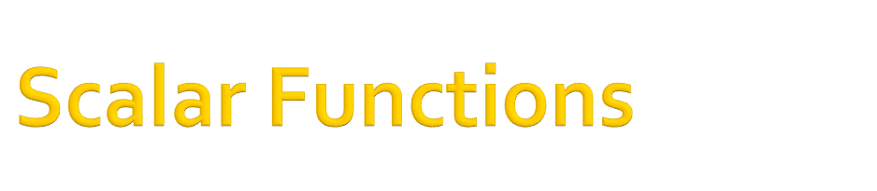
Just functions, as you might expect. They’re strongly typed.
For example:
length(s)
The length of a string. Will generate an error if s is not a string.
distance(x1,y2,y1,y2)
Distance from (x1,y1) to (x2,y2)
feps(f), deps(d)
These set the epsilon for floats or doubles. They always return true, so they can be used like this:
x y (deps(1e-10), x!=y);
Setting an epsilon stays until the next change. So, in this case, double epsilon will be 1e-10 until the next deps() call, regardless of scope.

Slide 17

Vector Functions are functions that work on entire “vectors” of values in the tightest enclosing context. All other values are considered scalars. Vector functions make the most sense in Cumulative Constraints, but they can be used anywhere.
For example:
{ x (x>0); [sum(x)<10000] }
Read positive integers, one per line, until EOF. Make sure that their sum does not exceed 10000.
{ x (x>0); [unique(x)] }
Read positive integers, one per line, until EOF. Make sure that no integer appears twice.
{ x (x>0, sum(x)<5*x#); }
Read positive integers, one per line, until EOF. Make sure that, at every point, the sum of the x’s is less that 5 times the number of x’s read so far.

Slide 18

Vector Functions work over the closest enclosing scope, regardless of parameters.
For example:
{[*3]
n (0<=n<=10);
{[*5]
m (0<=m<=10);
[sum(m) + sum(n) + sum(6) + sum(n#) + sum(m#) < 10000]}
[sum(4) + sum(n+m) < 100]}
sum(m) will be the sum of m values, as expected.
sum(n) will be 5 * the current n value
sum(6) will be 30 (5*6)
sum(n#) will be 5 * the current count of the outer scope (1, 2 or 3)
sum(m#) will be 25 (5*5)
sum(4) will be 12 (3*4)
sum(n+m) will cause a parsing error, since m is not in the outer scope.

Slide 19

The unique() function takes any number (>0) of arguments of any type. It’s the combination that’s checked for uniqueness.
For example:
{ x y (0<x, 0<y); [unique(x,y)] }
With this data:
5 6
5 5
6 5
6 6
6 5 ⬅ This is the line that will violate the constraint.

Slide 20

Documentation
Testing
Better ways of handling strings
  Allow fixed-sized fields?
  Column-oriented?
  Read-to-end-of-line?
More data types (BigInteger, BigDecimal? char?)
Choose from a list of patterns
If the problem is non-fatal (like spaces), produce a “fixed” version of the input file
Test on Linux/Mac

Slide 21
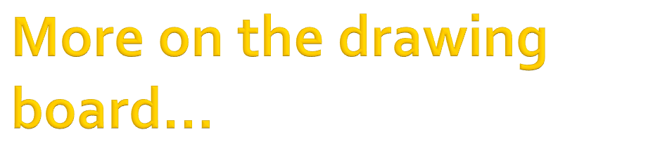
The unique() function doesn’t use epsilon to compare doubles/floats
sum(sum(x)) is O(n²), sum(sum(sum(x))) is O(n³)
  Need to store and reuse function evaluations
GUI
Pattern file:
prob5.viva
Load
Save
{[=n (n=0)]
n (1<=n<=10000);
}
Input files:
*.prob5
Test
<<<< Testing: test1.prob5 >>>>
<<<< Testing: test2.prob5 >>>>>
At line 1 token 1: Failed constraint: 1 <= n && n <= 10000

Slide 22
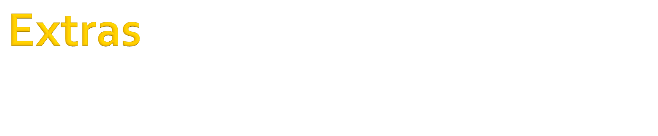

Slide 23
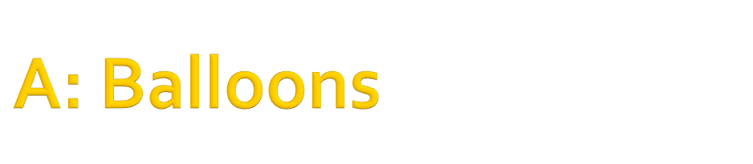
There will be several test cases in the input. Each test case will begin with a line with three integers:
N A B
Where N is the number of teams (1 ≤ N ≤ 1,000), and A and B are the number of balloons in rooms A and B, respectively (0 ≤ A,B ≤ 10,000). On each of the next N lines there will be three integers, representing information for each team:
K DA DB
Where K is the total number of balloons that this team will need, DA is the distance of this team from room A, and DB is this team’s distance from room B (0 ≤ DA,DB ≤ 1,000). You may assume that there are enough balloons – that is, Σ(K’s) ≤ A+B. The input will end with a line with three 0s.
{[=n a b (n=a=b=0)]
n (1<=n<=1000) a b (0<=a<=10000, 0<=b<=10000);
{[*n]
k da db (0<=da<=1000, 0<=db<=1000);
[sum(k)<=a+b]}
}

Slide 24
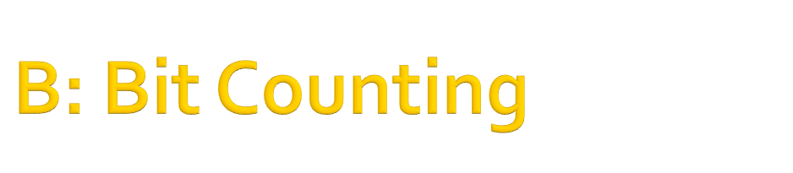
There will be several test cases in the input. Each test case will consist of three integers on a single line:
LO HI X
Where LO and HI (1 ≤ LO ≤ HI ≤ 10¹⁸) are the lower and upper limits of a range of integers, and X (0 ≤ X ≤ 10) is the target value for K. The input will end with a line with three 0s.
{[= lo:long hi:long x (lo=hi=x=0)]
lo:long hi:long (1<=lo<=hi<=1000000000000000000L)
x (0<=x<=10);
}

Slide 25
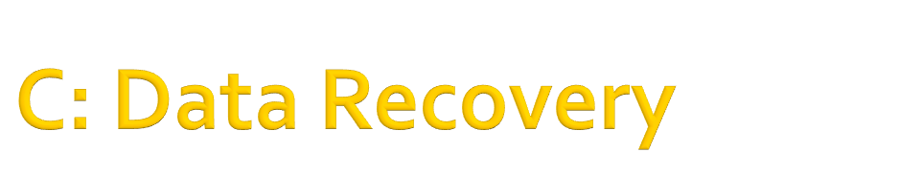
There will be several test cases in the input. Each test case will begin with one line containing two integers N and M (1 ≤ N,M ≤ 50), the dimension of the table. Then, the next N lines will each contain M integers. Each integer will be either between 0 and 100 inclusive, or the value -1. After the N lines containing table entries, there will be two more lines. The first line will contain N integers, each between 0 and 5,000 inclusive, indicating the sum of each row in the table, from topmost row to the bottommost row. The second line will contain M integers, each between 0 and 5,000 inclusive, indicating the sum of each column in the table, from the leftmost column to the rightmost column. The input will end with a line which contains two 0s.
{[= n m (n=m=0)]
n m (1<=n<=50, 1<=m<=50);
{[*n]
<[*m] k (0<=k<=100 || k=-1)>;
}
<[*n] r (0<=r<=5000)>;
<[*m] c (0<=c<=5000)>;
}

Slide 26

There will be several test cases in the input. Each test case will consist of six integers on a single line:
AX AY BX BY CX CY
Each integer will be in the range from -100 to 100. These integers represent the three points of the triangle: (AX,AY), (BX,BY) and (CX,CY). The points are guaranteed to form a triangle: they will be distinct, and will not all lie on the same line. The input will end with a line with six 0s.
{[= <[*6] x (x=0)>]
<[*3]
x y (-100<=x<=100, -100<=y<=100)
[(y[1]-y[0])*(x[2]-x[0]) != (y[2]-y[0])*(x[1]-x[0])]>;
}

Slide 27

There will be several test cases in the input. Each test case will begin with two integers, N and M (1 ≤ N,M ≤ 1,000) indicating the number of rows and columns of the matrix. The next N lines will each contain M space-separated integers, guaranteed to be either 0 or 1. The input will end with a line with two 0s.
{[= n, m (n=m=0)]
n m (1<=n<=1000, 1<=m<=1000);
{[*n]
<[*m] k (k=0 || k=1)>;
}
}

Slide 28
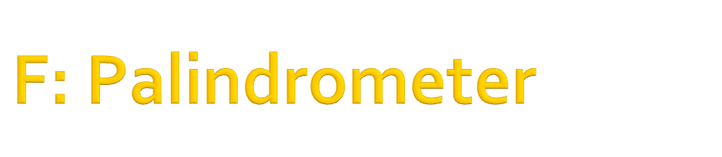
There will be several test cases in the input. Each test case will consist of an odometer reading on its own line. Each odometer reading will be from 2 to 9 digits long. The odometer in question has the number of digits given in the input - so, if the input is 00456, the odometer has 5 digits. There will be no spaces in the input, and no blank lines between input sets. The input will end with a line with a single 0.
{[= s:string (s % “0”)]
s:string (s % “[0-9]+”, 2<=length(s)<=9);
}

Slide 29

There will be several test cases in the input. Each test case will begin with an integer N (1 ≤ N ≤ 250,000) on its own line, indicating the number of days. On each of the next N lines will be a single integer P (-100 ≤ P ≤ 100), indicating the profit for that day. The days are specified in order. The input will end with a line with a single 0.
{[= n (n=0)]
n (1<=n<=250000);
{[*n]
p (-100<=p<=100);
}
}

Slide 30
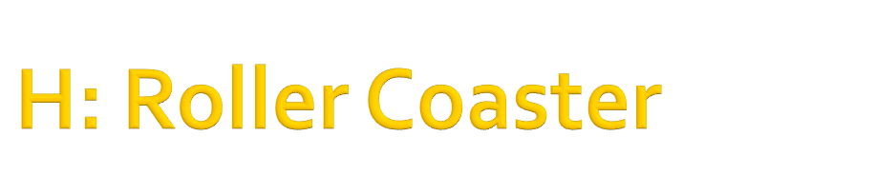
There will be several test cases in the input. Each test case will begin with a line with three integers:
N K L
Where N (1 ≤ N ≤ 1,000) is the number of sections in this particular roller coaster, K (1 ≤ K ≤ 500) is the amount that Bessie’s dizziness level will go down if she keeps her eyes closed on any section of the ride, and L (1 ≤ L ≤ 300,000) is the limit of dizziness that Bessie can tolerate – if her dizziness ever becomes larger than L, Bessie will get sick, and that’s not fun!
Each of the next N lines will describe a section of the roller coaster, and will have two integers:
F D
Where F (1 ≤ F ≤ 20) is the increase to Bessie’s total fun that she’ll get if she keeps her eyes open on that section, and D (1 ≤ D ≤ 500) is the increase to her dizziness level if she keeps her eyes open on that section. The sections will be listed in order. The input will end with a line with three 0s.
{[= N K L(N=K=L=0)]
N (1<=N<=1000) K (1<=K<=500) L (1<=L<=300000);
{[*N]
F (1<=F<=20) D (1<=D<=500);
}
}

Slide 31

There will be several test cases in the input. Each test case will consist of a single line containing a single integer N (3 ≤ N ≤ 1,000), which represents the number of skyscrapers. The heights of the skyscrapers are assumed to be 1, 2, 3, …, N. The input will end with a line with a single 0.
{[= n (n=0)]
n (3<=n<=1000);
}

Slide 32

There will be several test cases in the input. Each test case will begin with an integer N (2 ≤ N ≤ 1,000), which is the number of points in the city. On each of the next N lines will be two integers, X and Y (-1,000 ≤ X,Y ≤ 1,000), which are the (X,Y) locations of the N points. Within a test case, all points will be distinct. The input will end with a line with a single 0.
{[= n (n=0)]
n (2<=n<=1000);
{[*n]
x y (-1000<=x<=1000, -1000<=y<=1000);
[unique(x,y)]}
}

